Slide 1

Project Blink
Proof of Speed - 1.1 Block Architecture

Slide 2
Epochs, Slots, Packets, Blocks, Blinks, Snips

Slide 3
Epochs
Definition : an extended period of time usually characterized by a distinctive development or by a memorable series of events
A time-frame for mining a set of blocks
To decide on a set of rules by validators
In Blinkchain - 1 Epoch = 10,000 Blocks
For each epoch a epoch leader will be announced
1 Epoch (ϵ) = 10,000 Blocks

Slide 4
Slots
A shorter part of an epoch
This is to have a control or a overlook over a shooter period of time, hence more precision
For Each slot a leader will be announced
1 Slot = 400 Blocks

Slide 5
Packets
Epochs, Slots and Packets are distinguished to announce leaders of it.
Each Packet leader is the block’s producer/miner
Packet contains the block
In an epoch there are 10,000 packets similar to 10,000 blocks
1 Packet = 1 Block

Slide 6
1 Epoch = 10,000 Blocks ; 25 Slots ; 10,000 Packets
1 Slot= 400 Blocks ; 400 Packets
1 Packet = 1 Block

Slide 7
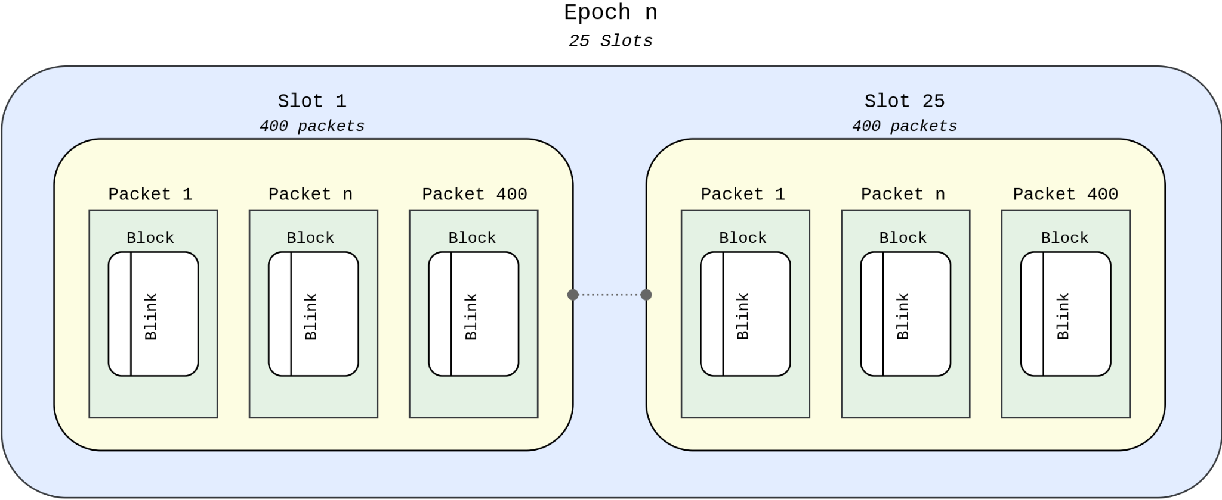

Slide 8
Time Period
Time of an Epoch, Slot directly related to block-time
During genesis blocks, an epoch will be approximately 1 hr
Blinkchain has Mutable Block Time which will lead to difference in time period
1 Epoch ≈ 1 hour ;
1 Slot ≈ 2 mins ;
1 packet ≈ 325 ms

Slide 9
Blinks & Snips
Blinks are blocks but it is represented in terms of time-passed
The time from first transaction added to the block till the last is a blink
Snips are Indivisible chunks of a Blink generated in a hash-sequence
Snips are added to form a blink ; a blink is a block produced by the packet leader.
More on Blinks and snips are in later presentations

Slide 10
Next : 1.2 Block Size per second

